Slide 1






Data Security and Cryptology -
Final Project
Secure payment, Schnorr Signature for server identification. SM4 encoder – decoder ECDH key generation.
Dor Shabat - 316575620
Yuval Rozner - 207756552
Our Implemantion in Colab Notebook

Slide 2
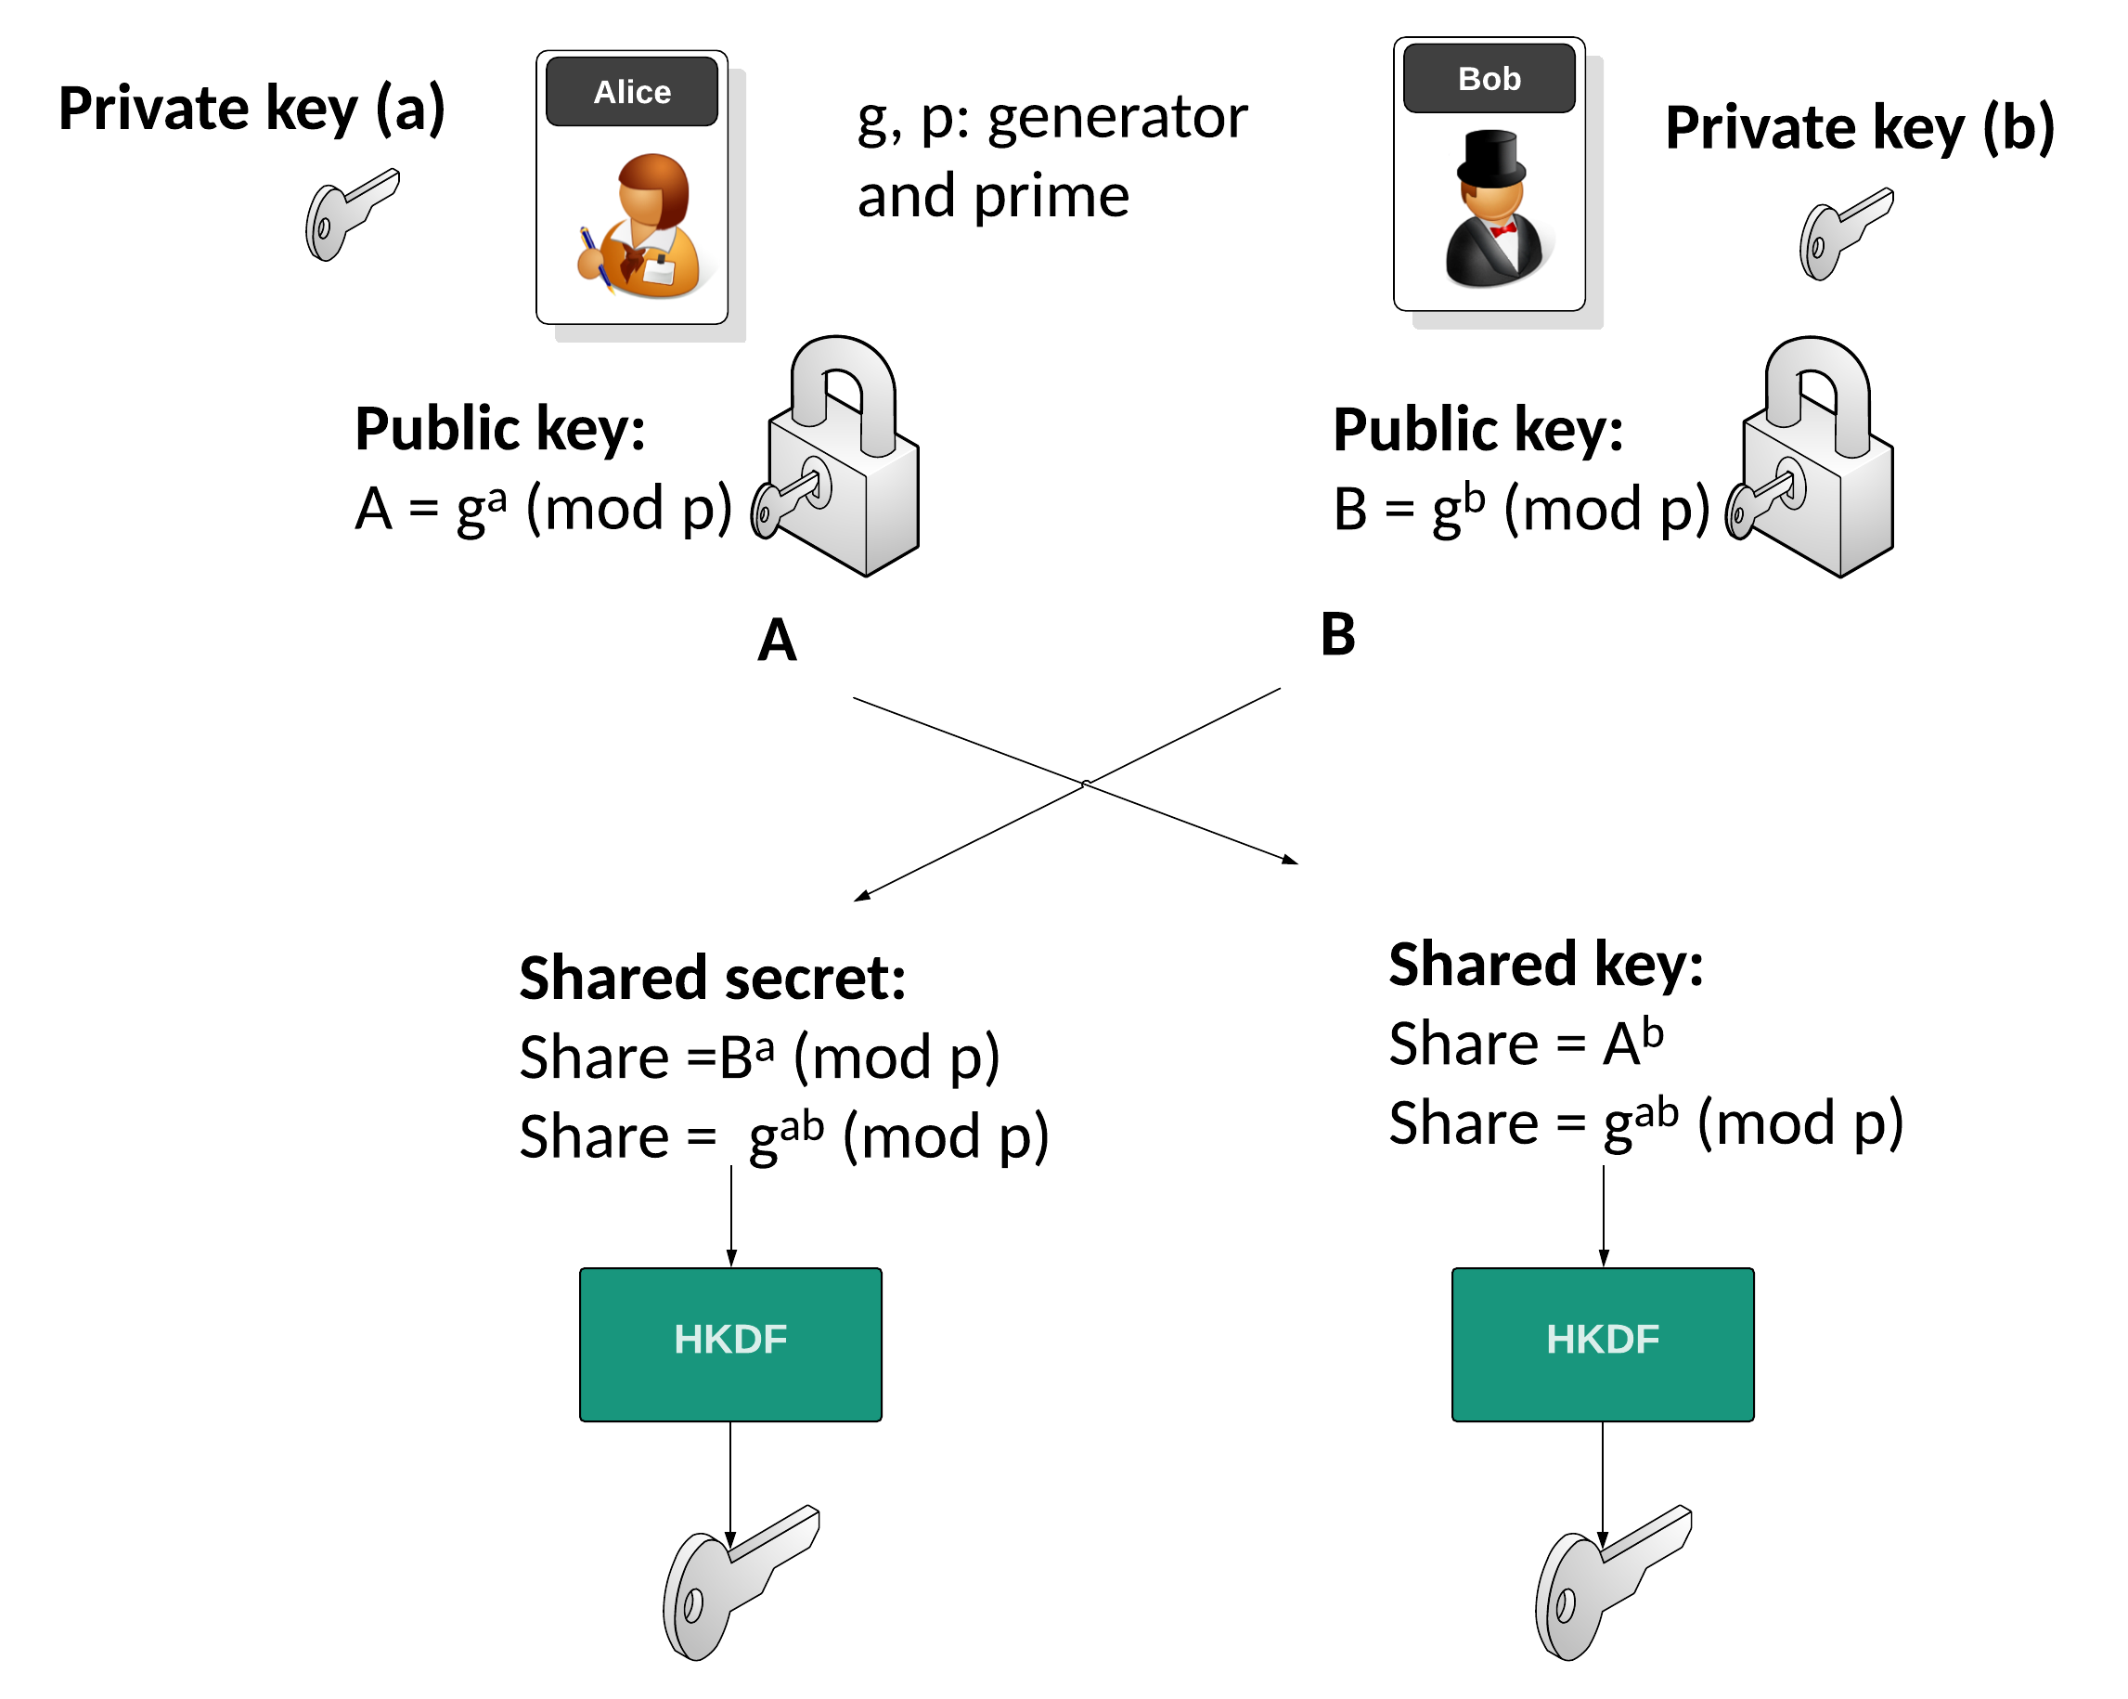
ECDH
Elliptic Curve Diffie-Hellman

Slide 3
What is ECDH ?
Secure Key Exchange:
In cryptography, secure key exchange is crucial for protecting communication channels.
Ensures that only the intended parties can access the shared secret key.
Evolution of Diffie-Hellman:
The classical Diffie-Hellman key exchange method was introduced in 1976.
ECDH (Elliptic Curve Diffie-Hellman) is an advanced version, leveraging elliptic curves for enhanced security and efficiency.

Slide 4

Basics of Elliptic Curves
Definition:
Elliptic curves are defined by the equation $y^{2}=x^{3}+ax+b$, where $a$ and $b$ are constants.
These curves have unique mathematical properties that make them useful in cryptography.
Key Properties:
The difficulty of solving the Elliptic Curve Discrete Logarithm Problem (ECDLP) forms the basis of security.
Smaller key sizes compared to other cryptographic systems provide equivalent security levels, leading to faster computations and reduced storage requirements.

Slide 5
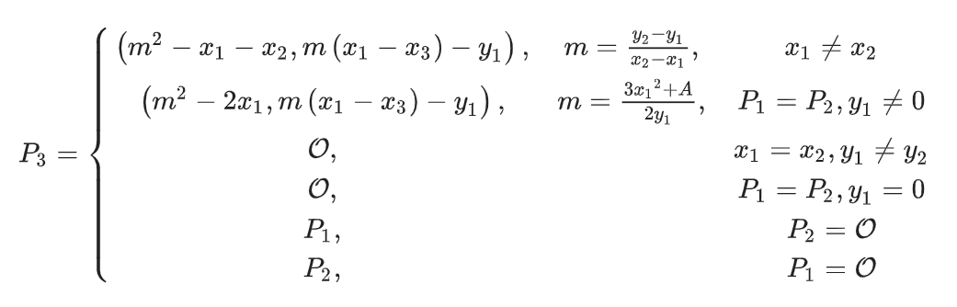
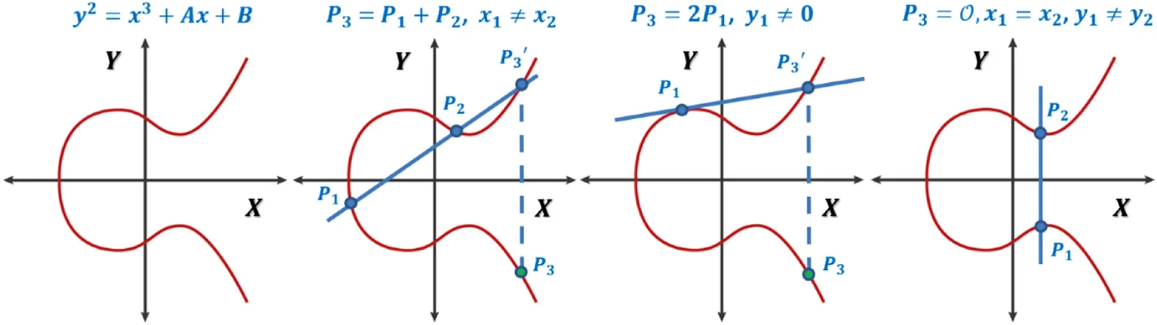
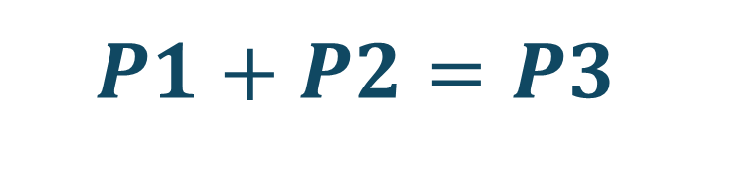
$$P1+P2=P3$$

Slide 6
Key Exchange Principles
Overview of Key Exchange:
Key exchange is the process by which cryptographic keys are securely shared between parties.
Ensures that both parties can communicate securely without prior shared secret keys.
Public and Private Keys:
Each party generates a pair of keys: a private key (kept secret) and a public key (shared openly).
The security of the system relies on the private key remaining confidential.

Slide 7
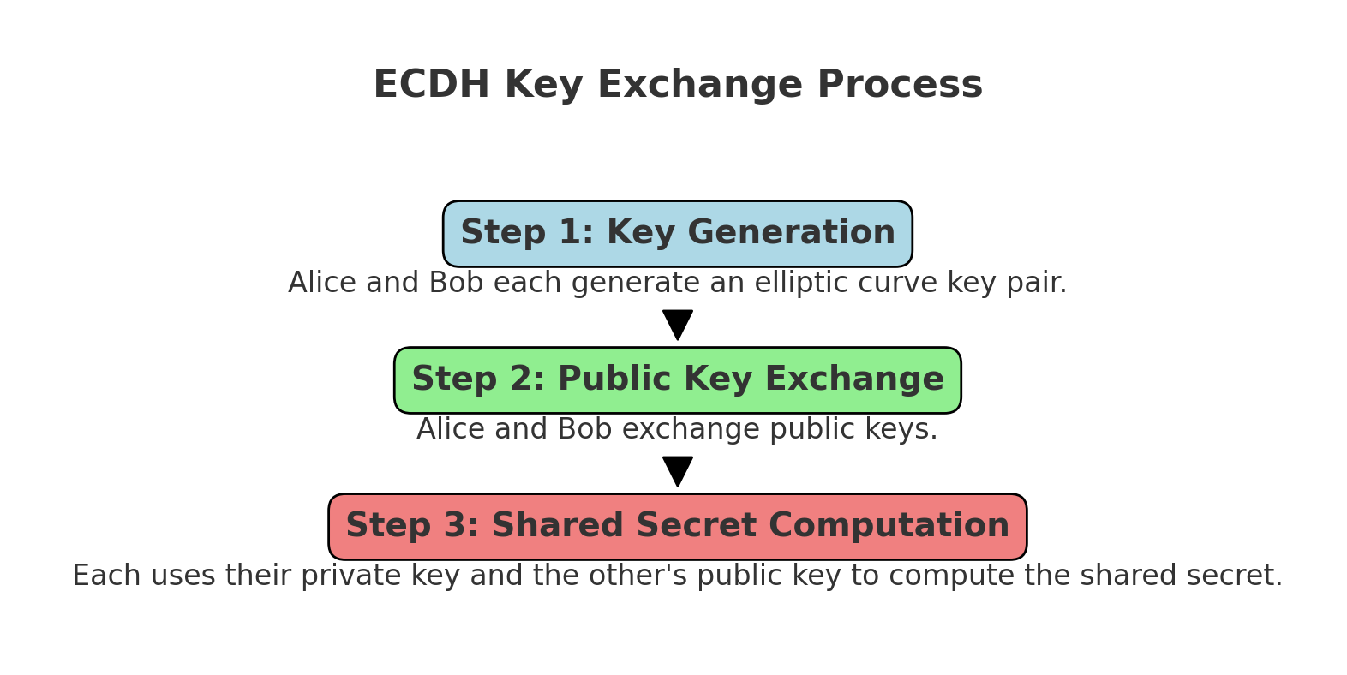
Key Exchange Process

Slide 8

Security Aspects of ECDH
Elliptic Curve Discrete Logarithm Problem (ECDLP):
The security of ECDH relies on the difficulty of solving the ECDLP.
Given a point $P$ and a multiple $Q=kP$on an elliptic curve, it is computationally infeasible to determine $k$ if $k$ is large.
Elliptic Curve Diffie-Hellman (ECDH):
ECDH achieves the same level of security with smaller key sizes compared to classical Diffie-Hellman.
For example, a 256-bit key in ECDH provides comparable security to a 3072-bit key in classical Diffie-Hellman.

Slide 9
SM4

Slide 11


Schnorr Signature

Slide 12
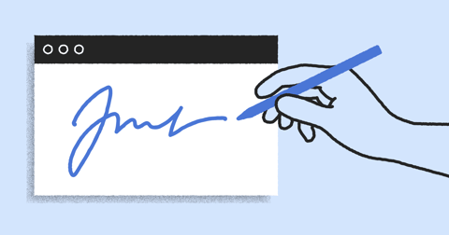
Why Digital Signature ?
Digital signatures are crucial in cryptography, ensuring message authenticity and integrity.
They verify the sender's identity and protect against message tampering.
Authenticity: Confirms the sender's identity.
Integrity: Ensures the message hasn't been altered.
Prevents Man-in-the-Middle Attacks: Stops attackers from intercepting and modifying messages.
Non-repudiation: The sender cannot deny having sent the message.
Digital signatures are essential in email, financial transactions, and legal documents.
Notes:
חתימות דיגיטליות חשובות באבטחת מידע:
- הן מסייעות לנו לאמת את זהות השולח.
- לוודא את שלמות ההודעה (שלא שינו לנו אותה בדרך).
- למנוע התקפות איש בבדרך.
- להימנע מצב שבו השולח יכול להתנער משליחת ההודעה.

Slide 13
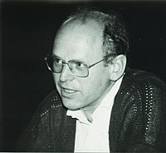
What is Schnorr Signature ?
Schnorr Signature is a digital signature algorithm known for its simplicity, efficiency, and security.
Invented by: Claus-Peter Schnorr.
Advantages:
More efficient than many other digital signature algorithms.
Provides strong security guarantees.
Applications: Used in various cryptographic protocols and blockchain technologies.
Notes:
הומצא על ידי קלאוס פטר סנור.
יעיל יותר מרוב החתימות הדיגיטליות שקיימות היום.

Slide 14
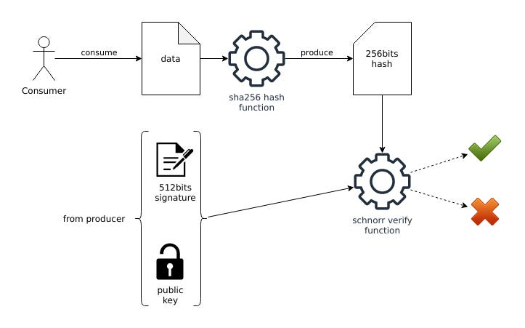
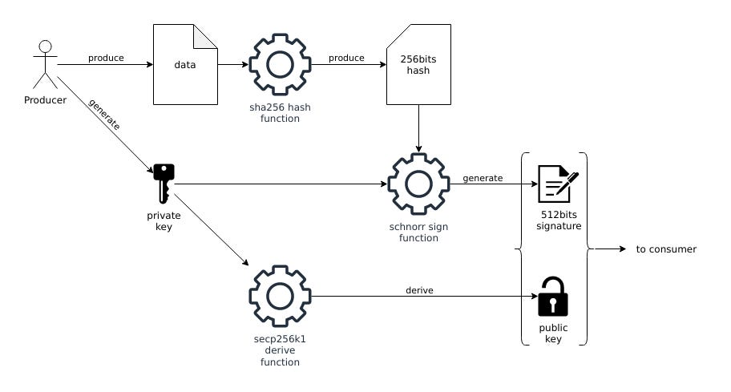
Schnorr Signature Diagrams
sender
receiver

Slide 15

Schnorr Signature Algorithm
Algorithm Steps:
Key Generation:
Alice generates a private key $s$ and a public key $V=A^{−s} mod p$.
Signing:
Alice selects a random nonce $r$ and computes $x=A^{r} mod p$.
Alice hashes the message and $x$ to create $e=H\left(M,x\right).$
Alice computes the signature $y=(r+se) mod q$.
Verification:
Bob receives $(M, y, e)$ and computes $x^{′}=A^{y}⋅V^{e} mod p$.
Bob verifies that $e=H(M, x^{′})$.
Notes:
הומצא על ידי קלאוס פטר סנור.
יעיל יותר מרוב החתימות הדיגיטליות שקיימות היום.

Slide 16
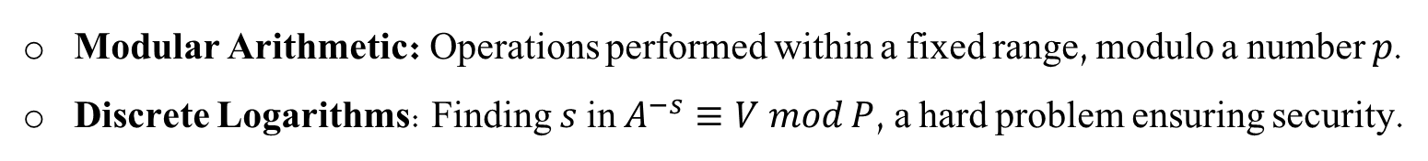
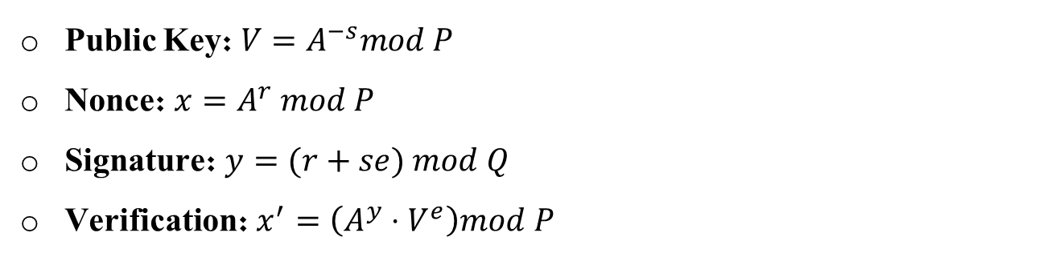
Mathematical Foundations
Mathematical Concepts:
Modular Arithmetic: Operations performed within a fixed range, modulo a number 𝑝.
Discrete Logarithms: Finding $s$ in $A^{−s}≡V mod P$, a hard problem ensuring security.
Key Equations:
Public Key: $V=A^{−s}mod P$
Nonce: $x=A^{r} mod P$
Signature: $y=(r+se) mod Q$
Verification: $x^{′}=\left(A^{y}⋅V^{e}\right)mod P$
Notes:
הומצא על ידי קלאוס פטר סנור.
יעיל יותר מרוב החתימות הדיגיטליות שקיימות היום.

Slide 17
Thank You !
Our Implemantion in Colab Notebook
Dor Shabat - 316575620
Yuval Rozner - 207756552

